Slide 1

Event Hub
Group 2

Slide 2
Objective
To build a unified event management system for organizers and attendees.
To allow organizers to create, update, and manage their events easily.
To enable users to discover, search, and book events conveniently.
To ensure smooth integration using a hybrid, API-driven MERN stack.
To include features like ticketing, payments, analytics, and engagement tools.

Slide 3
Problem Statement
Organizers find it hard to create, promote, and manage events easily.
No single platform to handle all event tasks in one place.
Users face problems finding and booking events quickly.
There are no real-time updates or easy ways to engage attendees.

Slide 4
Motivation
To make event creation and management easy in one platform.
To help users quickly find and book events.
To give organizers better reach and easy data handling.
To use modern MERN technology for a smooth and scalable system.

Slide 5
Target Users
Individual Organizers: Host small events like workshops or parties.
Event Agencies: Manage multiple events, ticketing, and promotions.
Corporates: Organize conferences, webinars, and exhibitions.
Communities & Non-Profits: Run fundraisers and awareness programs.
Attendees: Discover, book, and attend events easily.

Slide 6
System Environment
Web-based platform accessible through browsers.
Compatible with desktop and mobile devices.
Connected to a secure backend server and database.
Hosted on cloud platforms for better performance and uptime.

Slide 7
Functional Requirements
User registration and login (attendee, organizer, admin).
Event creation, update, and deletion by organizers.
Event search and filter by category, location, or date.
Ticket booking and online payment (Razorpay).
Notifications and reminders for events.
Reviews and ratings after event completion.

Slide 8
Non-Functional Requirements
Performance: Fast response time (< 2 seconds).
Availability: High uptime (around 99%).
Security: JWT authentication and encrypted passwords.
Scalability: Should handle multiple users and events easily.
Usability: Simple and responsive UI.
Deployment: Hosted on Vercel for web accessibility.

Slide 9
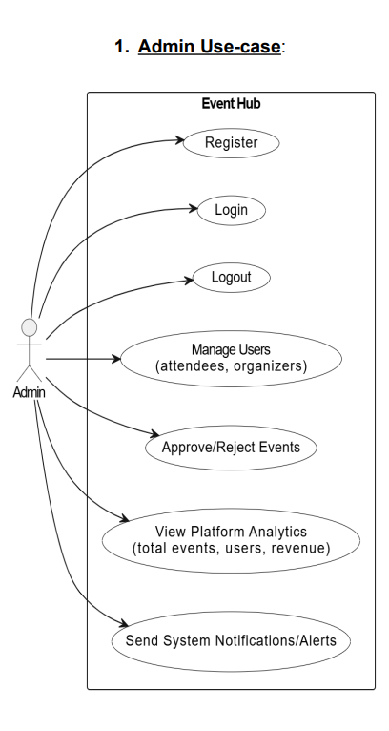
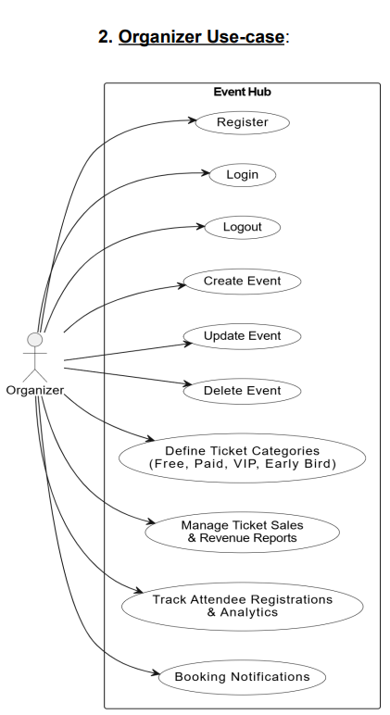
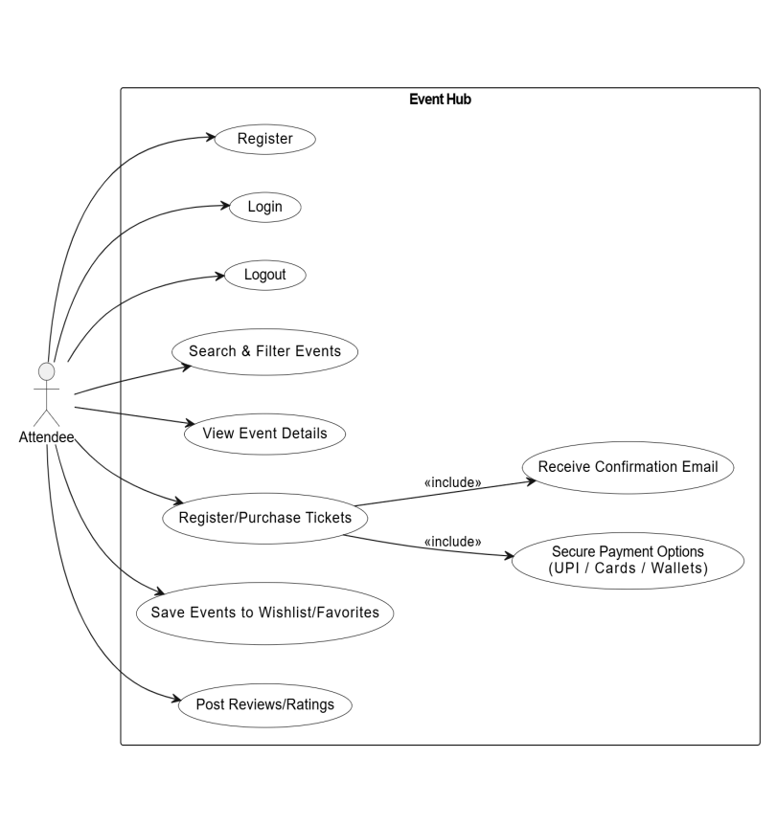

Use Case Diagram

Slide 10
User Stories
As a user, I want to search and book events easily so I can attend them.
As an organizer, I want to create and manage events so I can track ticket sales.
As an admin, I want to monitor all events and users to ensure smooth operations.

Slide 11
Technology Stack Justification
MongoDB: Used as the database for flexible and fast data storage of users, events, and bookings.
Express.js: Simplifies backend routing and API creation.
React.js: Provides a responsive and dynamic web interface for the admin panel.
Node.js: Handles server-side logic and ensures fast performance.

Slide 12
Thank You

